Slide 1
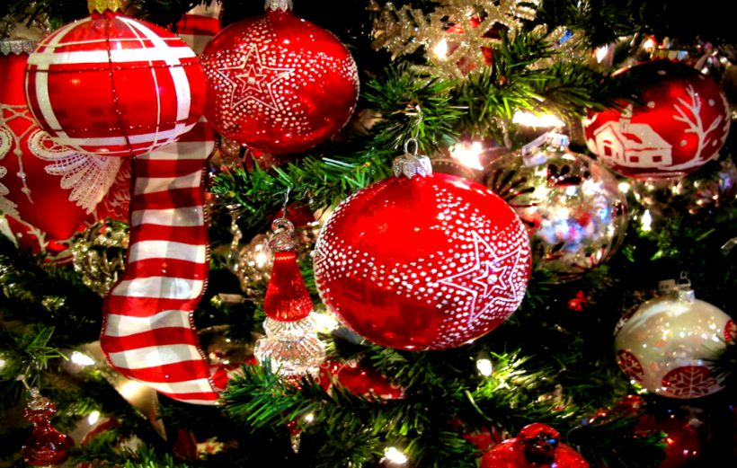
Merry Christmas
Alicja Lisowska kl.5b

Slide 2
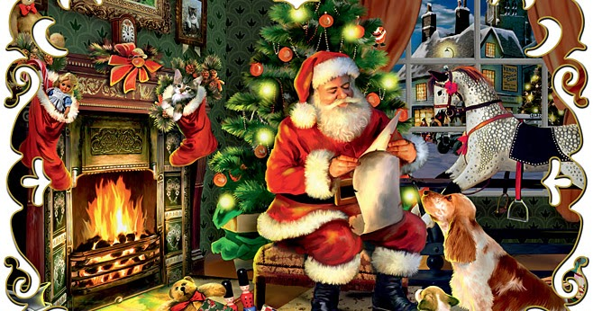
Santa Claus
Santa Claus

Slide 3
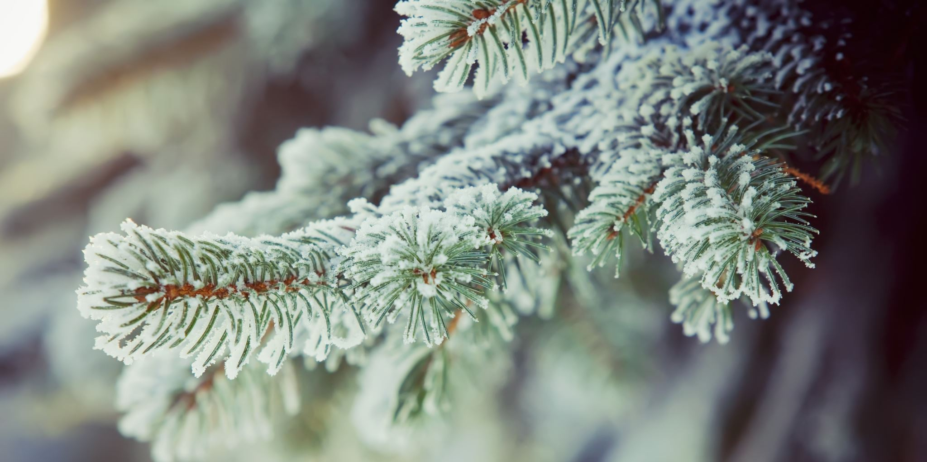
Christmas tree

Slide 4
Christmas gift

Slide 5
Christmas balls

Slide 6
Gingerbreads

Slide 7
Nativity scene
SA.

Slide 8
Mistletoe

Slide 9
Star of Bethlehem

