Slide 1
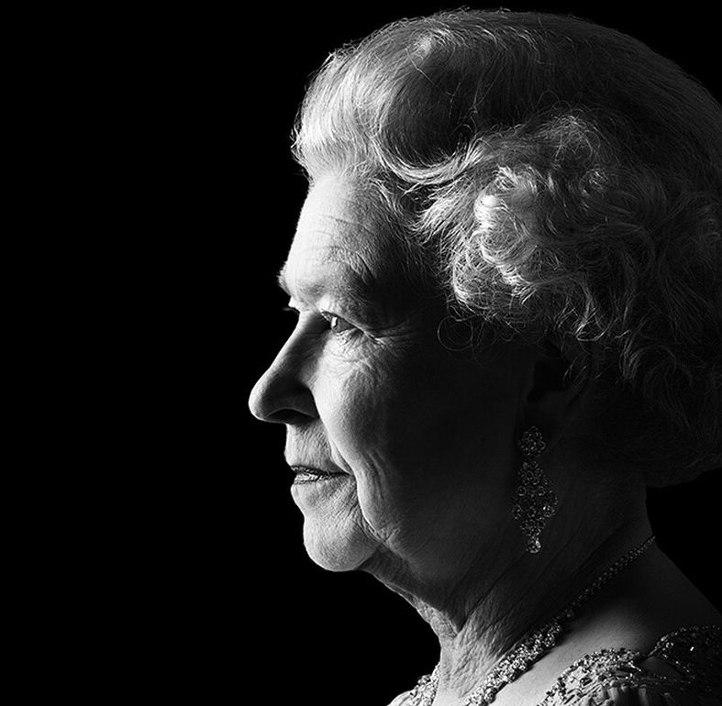
Queen Elizabeth II
Klaudia Chmielewska 7A

Slide 2
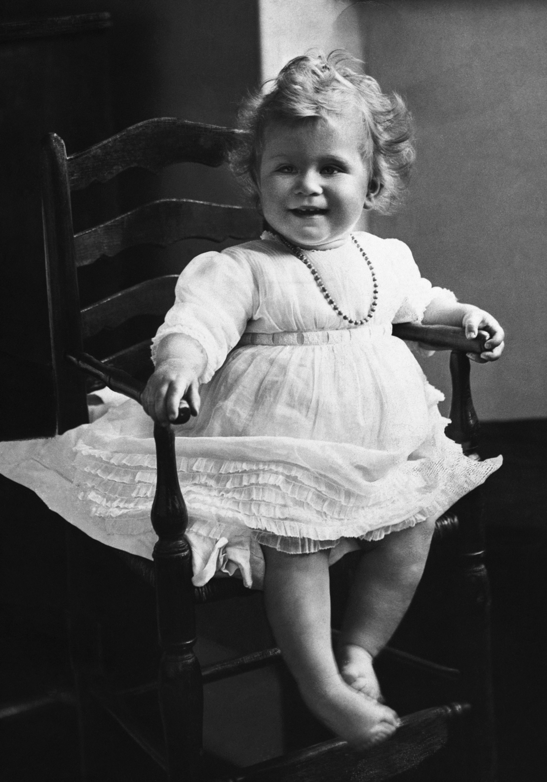
Where and when was Queen Elizabeth II born?
Queen Elizabeth was born at 2:40am on
the 21st of April 1926. She was born in
the Uk (United Kingdom) on Bruton street
in Mayfair, London. The home of her
maternal grandparents, the Earl and
Countess of Strathmore. The Queen was
the first child of the Duke and Duchess or York.

Slide 3
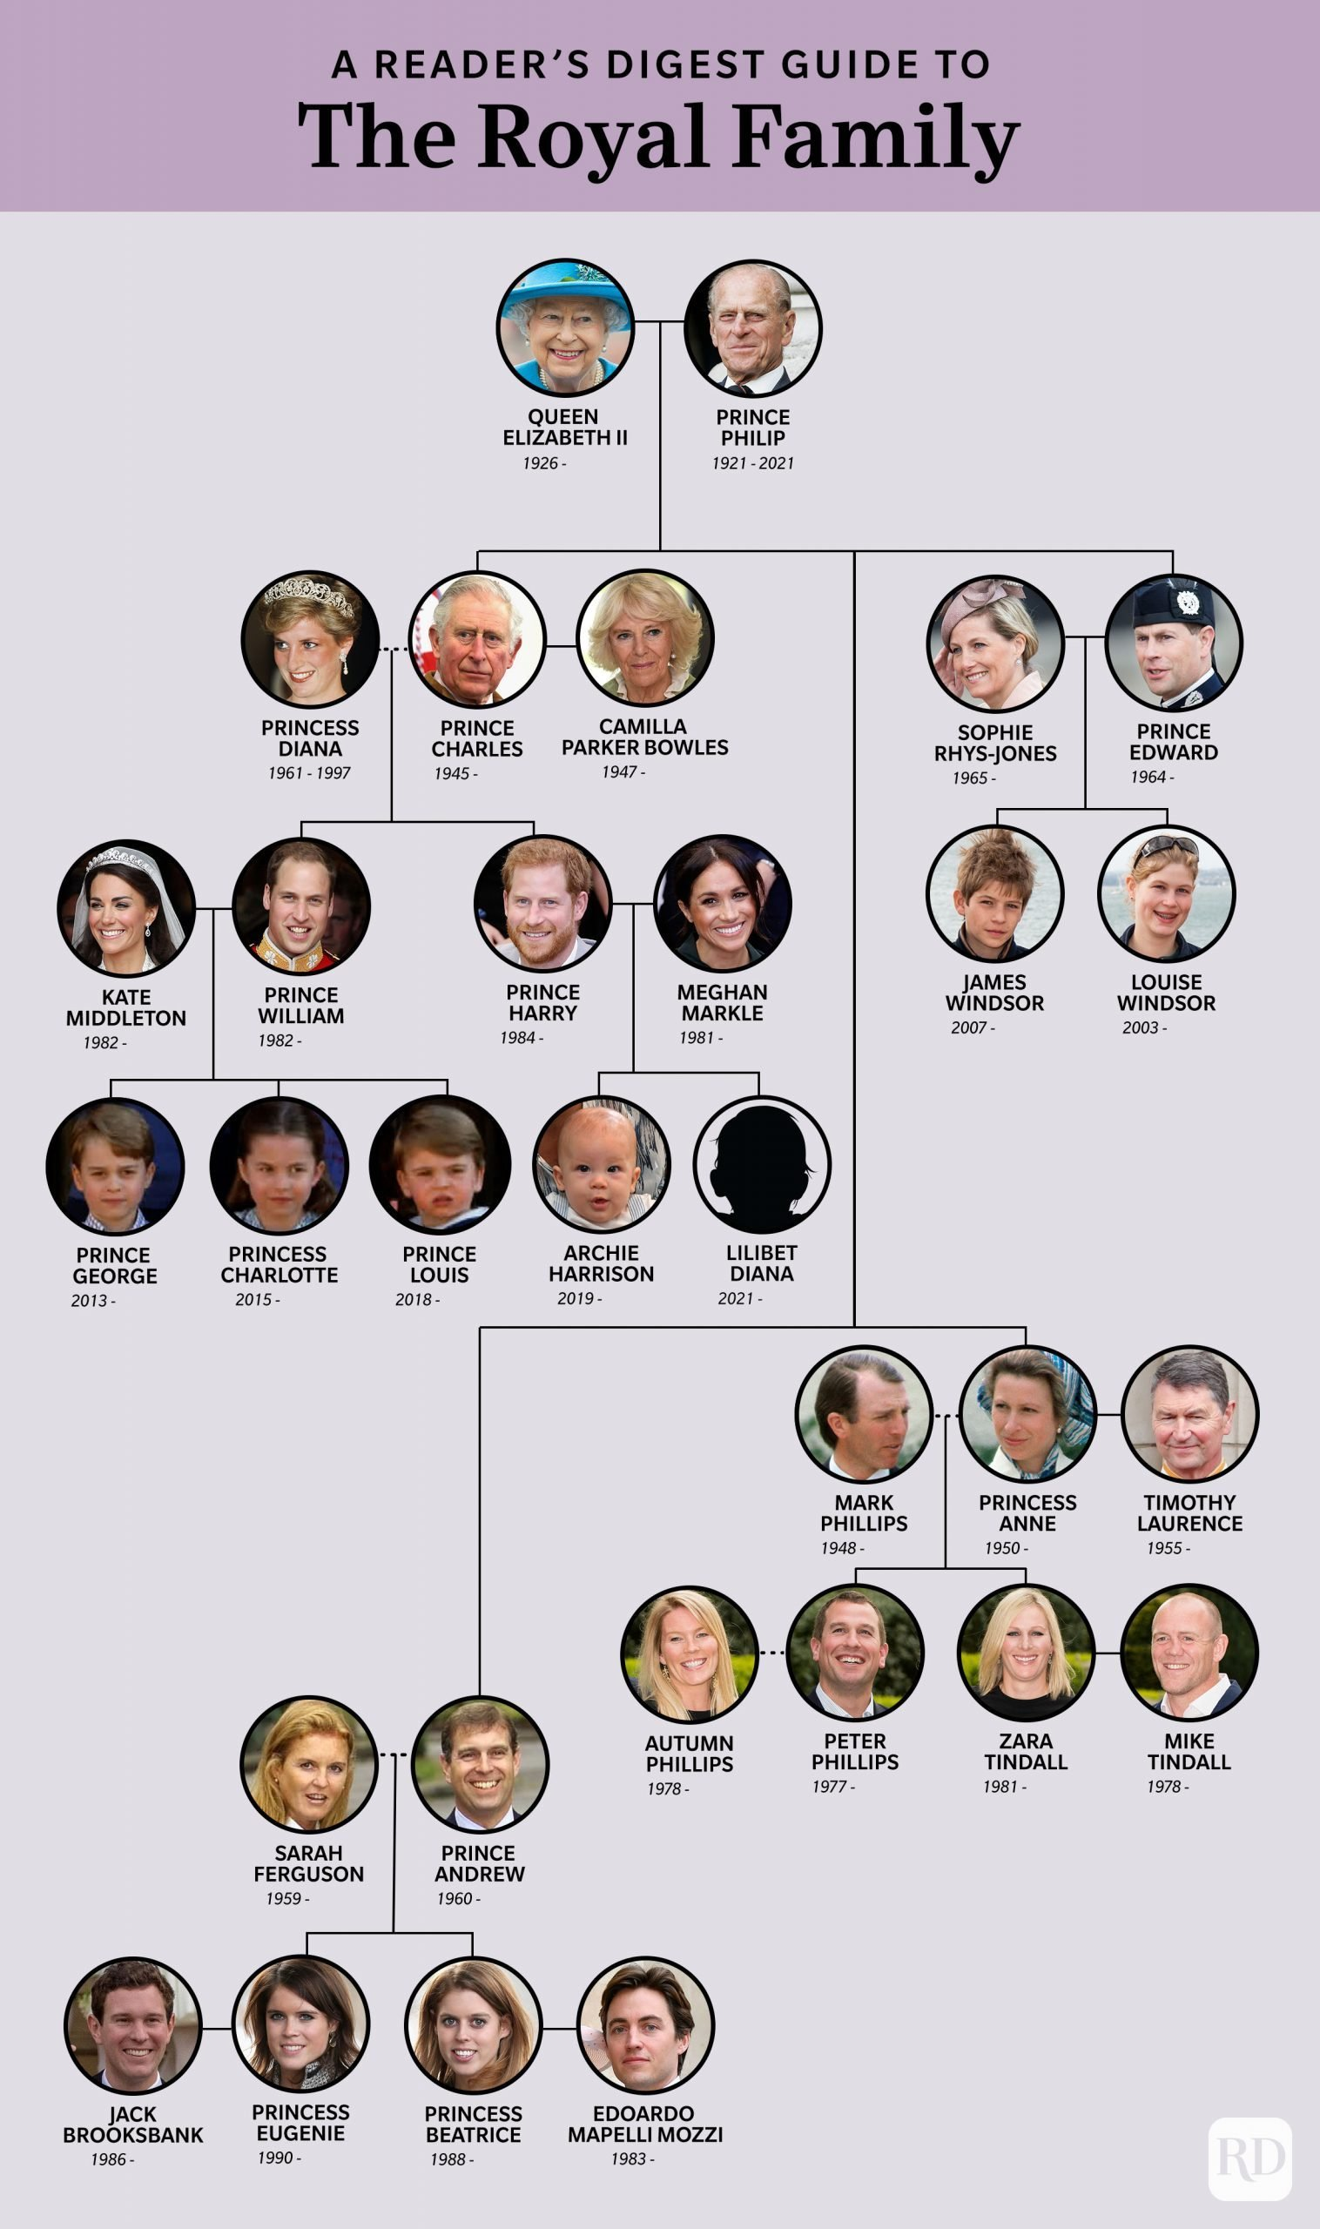
Queen Elizabeth’s family.
Queen Elizabeth married her husband Prince Philip, Duke of Edinburgh in 1947 on the 20th of November.
The Queen and Prince Philip both had 4 children together King Charles (born 1948), Princess Anne (born 1950), Prince Andrew (born 1959) and Prince Edward (born 1963).
Queen Elizabeth’s grandchildren :
Peter Phillips.
Zara Phillips Tindall.
Prince William.
Prince Harry.
Princess Beatrice.
Princess Eugenie.
Lady Louise Mountbatten-Windsor.
James Mountbatten-Windsor, Viscount Severn.

Slide 4
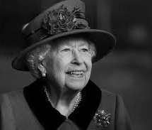
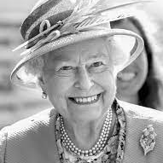
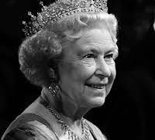
Queen Elizabeth’s death.
Queen Elizabeth died at Balmoral Castle at the age of 96 on the 8th of September 2022 and she died peacefully at 3.10pm UK time.
The Queens death certificate has revealed that she has died of old age.

Slide 5
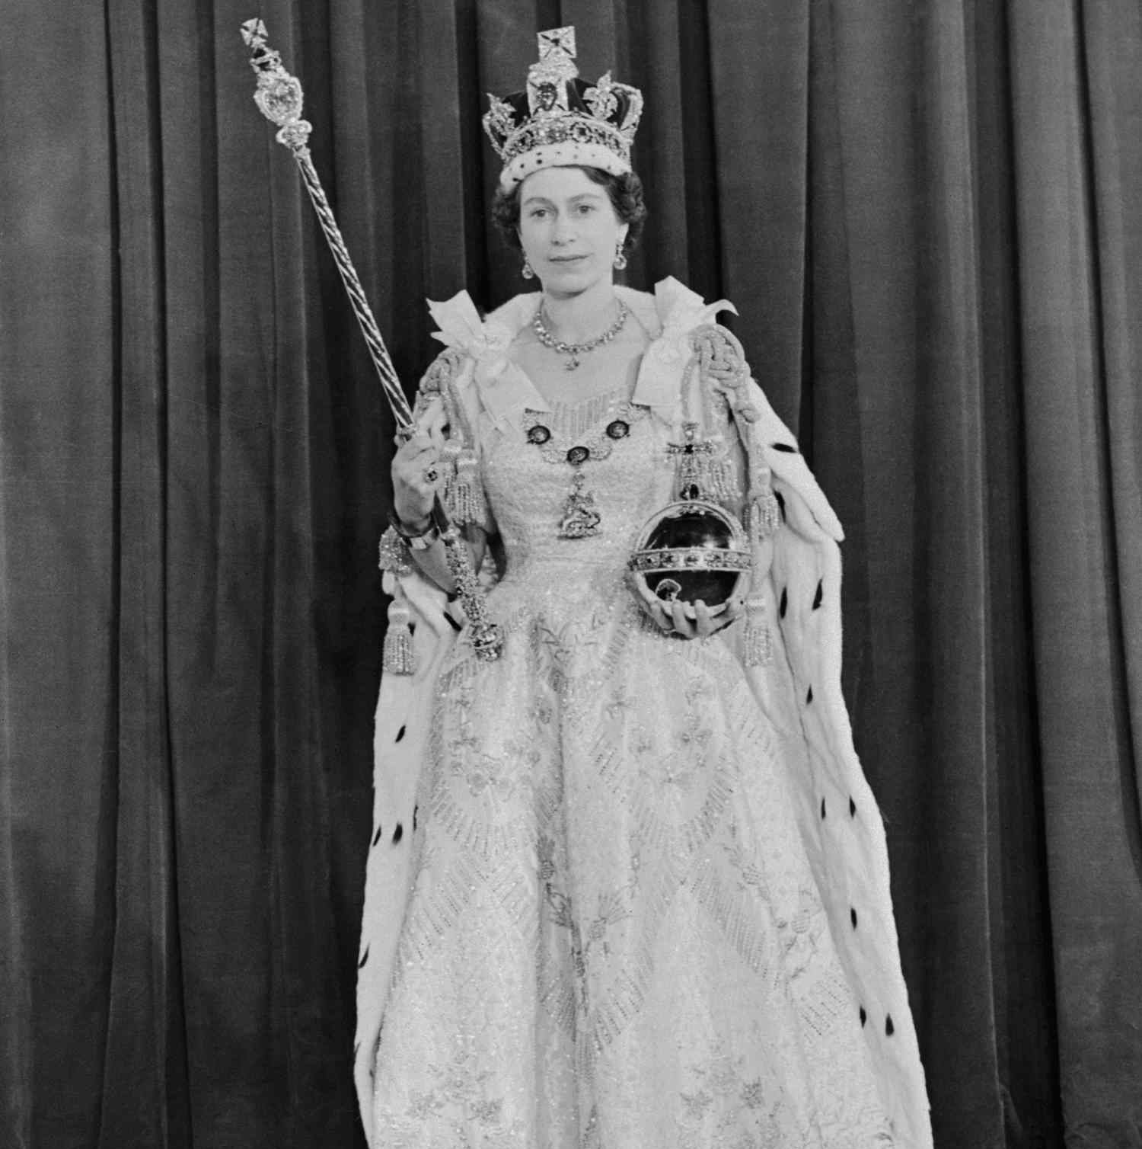
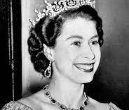
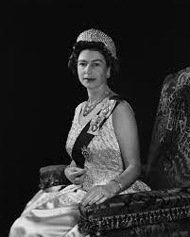
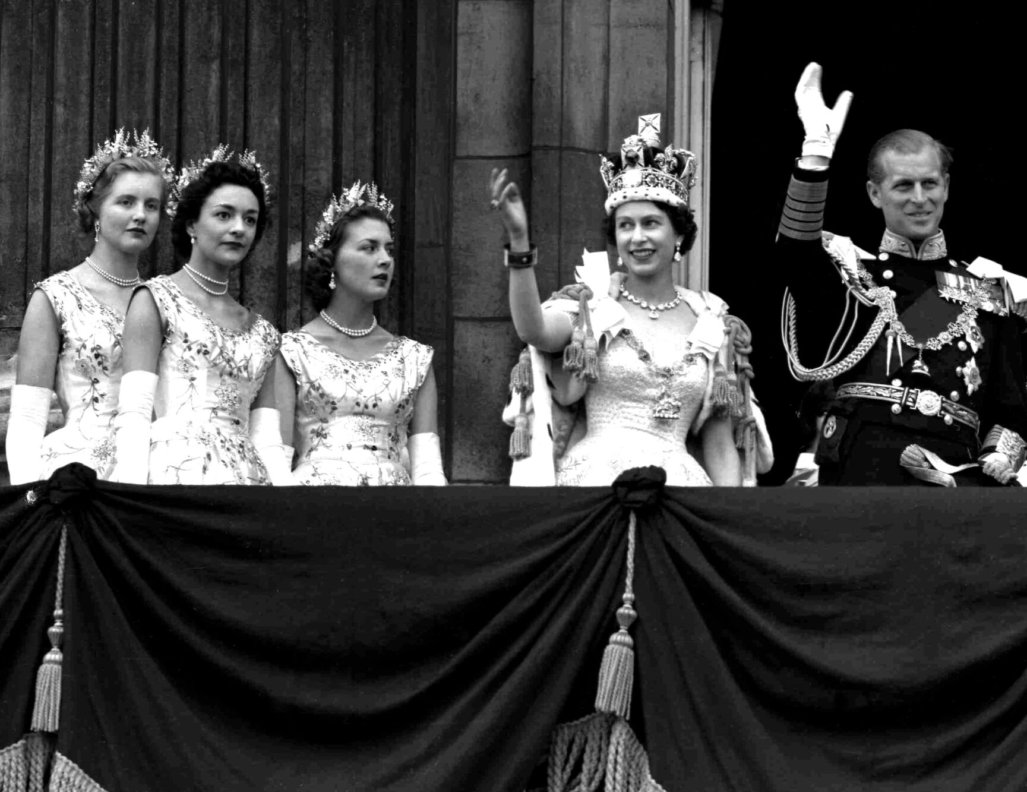
The coronation of Queen Elizabeth II.
The coronation of Queen Elizabeth II took place on the 2nd of June, 1953 at Westminster Abbey in London.
At the age of 25 she acceded to the throne upon the death of her farther George VI on the 6th of February 1952.
The coronation was held more than one year later after her fathers death because of the tradition of allowing an appropriate length of time to pass after a monarch dies before holding such an event.
She was also crowned Queen of the United Kingdom, Canada, Australia, New Zealand, South Africa, Pakistan and Ceylon (now Sri Lanka).

Slide 6
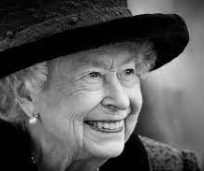
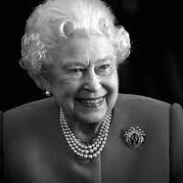
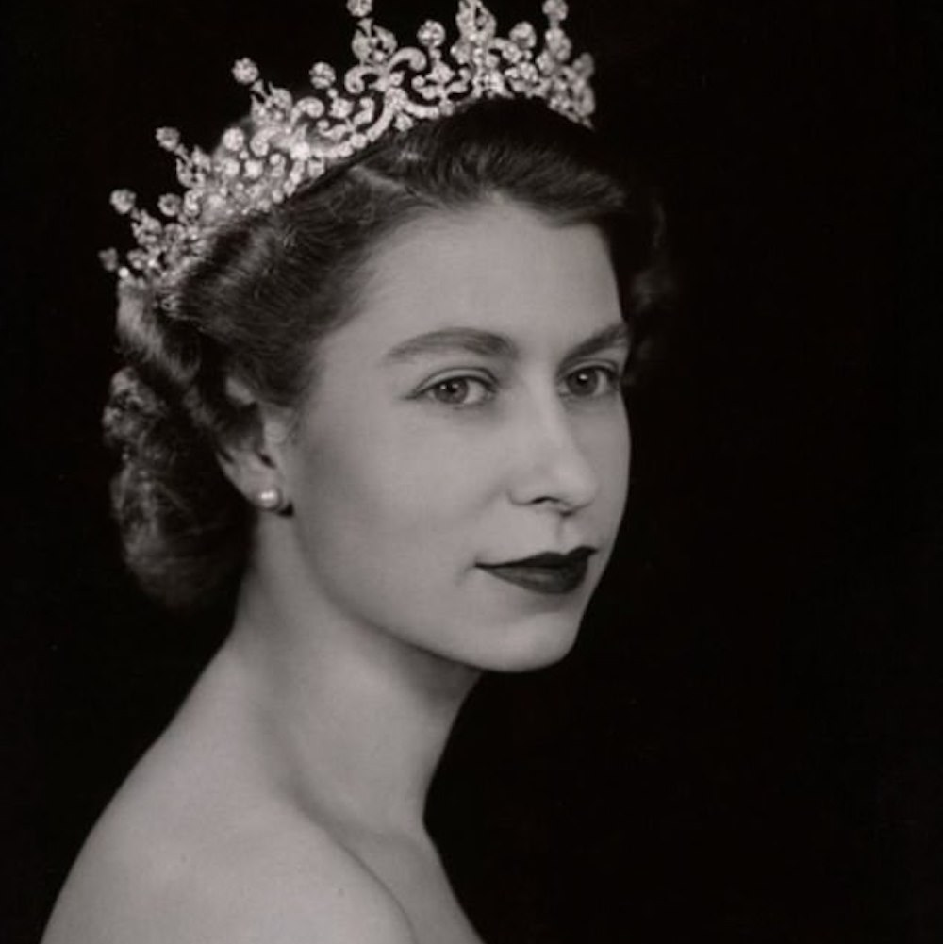
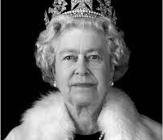
Fun facts about the Queen.
The Queen‘s first horse was called Peggy.
The Queen has owned over 30 corgis in total.
The Queen does not need a license to drive.
The Queen speaks fluent French.
She volunteered as a truck driver during World War II.
Her Majesty has travelled to more than 100 countries.
The Queen enjoyed outdoor life.
It has been said that the Queen went to sleep at the same time every night, 11pm and woke up at 7:30 each day.
It has been revealed that the Queen‘s favourite colour is blue.

