Slide 1
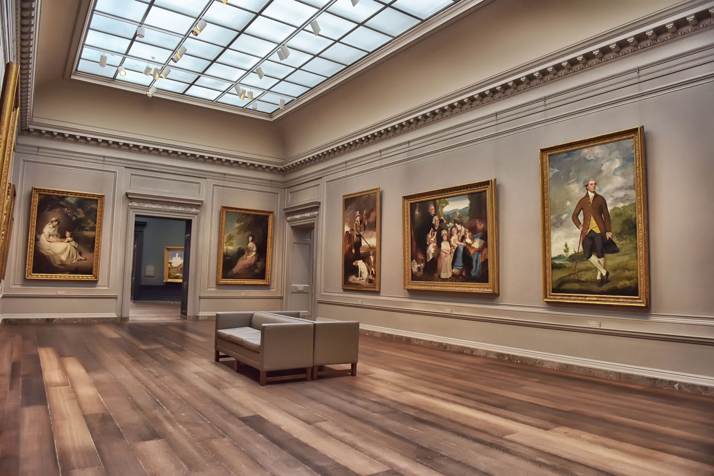
The dinosaur museum Anglický jazyk – 9. ročník
Mgr. Daniela Vallušová

Slide 2
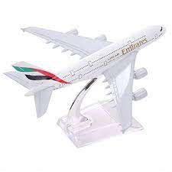
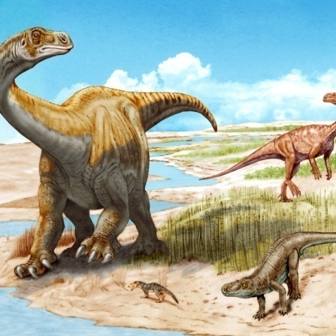
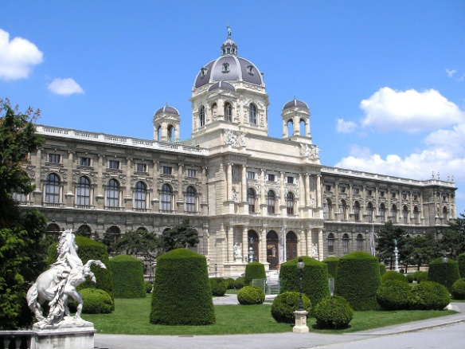
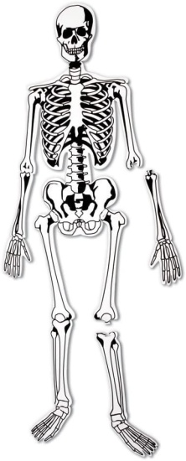
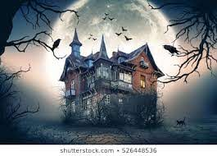
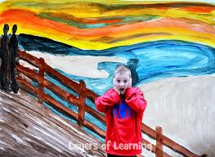
New words
dinosaur - dinosaurus
museum - múzeum
model - model
skeleton - kostra
scary - strašidelný
scream - krik

Slide 3
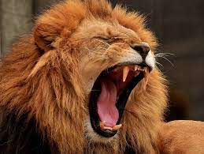
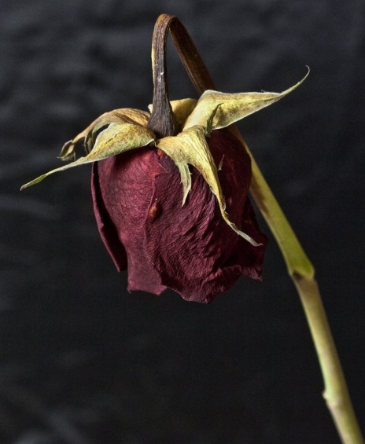
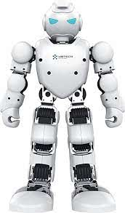
roar - rev
alive - živý
dead - mŕtvy
robot - robot

Slide 4
Past simple
Jednoduchý minulý čas vyjadruje dej, ktorý skončil v minulosti.
Vo vete ho môžeme rozoznať pomocou časových výrazov, ktoré nám referujú
minulosť.
nepravidelné slovesá – vzniká nové iné alebo niekedy aj to isté slovo.
Keďže sú nepravidelné neexistuje žiadne pravidlo na ich tvorbu.
go – went have - had
see – saw get - got
write – wrote write - wrote

Slide 5
Past simple: irregular verbs with negatives
We went to the dinosaur museum.
We didn´t go to school.
I saw dinosaurs.
I didn´t see fish.
buy – bought make – made
eat – ate see - saw
go – went think - thought
hear – heard wear - ware
learn – learnt write - wrote

Slide 6
Past simple: irregular verbs with questions
Did they go to a museum?
Yes, they did.
Did Amy buy a postcard?
No, she didn´t. She bought a model.
Which museum did you go to?
We went to the dinosaur one.
What did you see?
We saw dinosaur skeletons.

Slide 7
Write
We went (go) to a museum to learn about the life of children two thousand
years ago.
Most children then ........................ ( not go) to school and .........................
( not learn) to read.
Many children ......................(play) games in the street and with yo-yos and
wooden toys.
Boys ..................... ( not wear) trousers.
They ........................ (wear) short turnics, like a dress

